Slide 1


ECEN 404
Creating STEM Contents: Solar Power with a Tracking System
Final Presentation
Leo Predanic
George Thuita
Brandon Cenci
Sponsor: Dr. Won Jang
TA: Souryendu Das

Slide 2

Executive Summary
Problem statement:
To create the future of tomorrow, we must invest today - by getting students interested in STEM early
Our Solution:
Excite K-12 students by creating a portable solar system for demonstration purposes
Contain digestible figures & animations to describe/track system

Slide 3
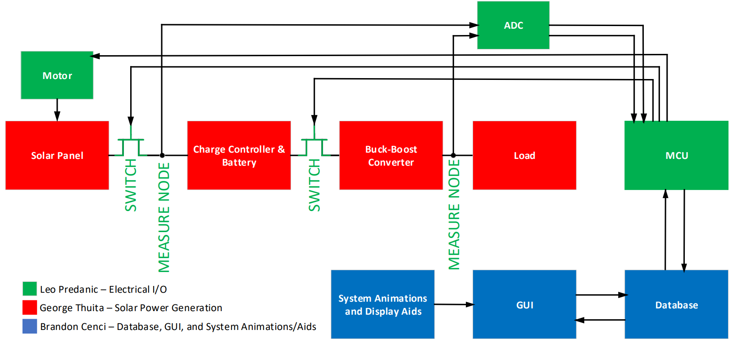
System Flow & Overview

Slide 4
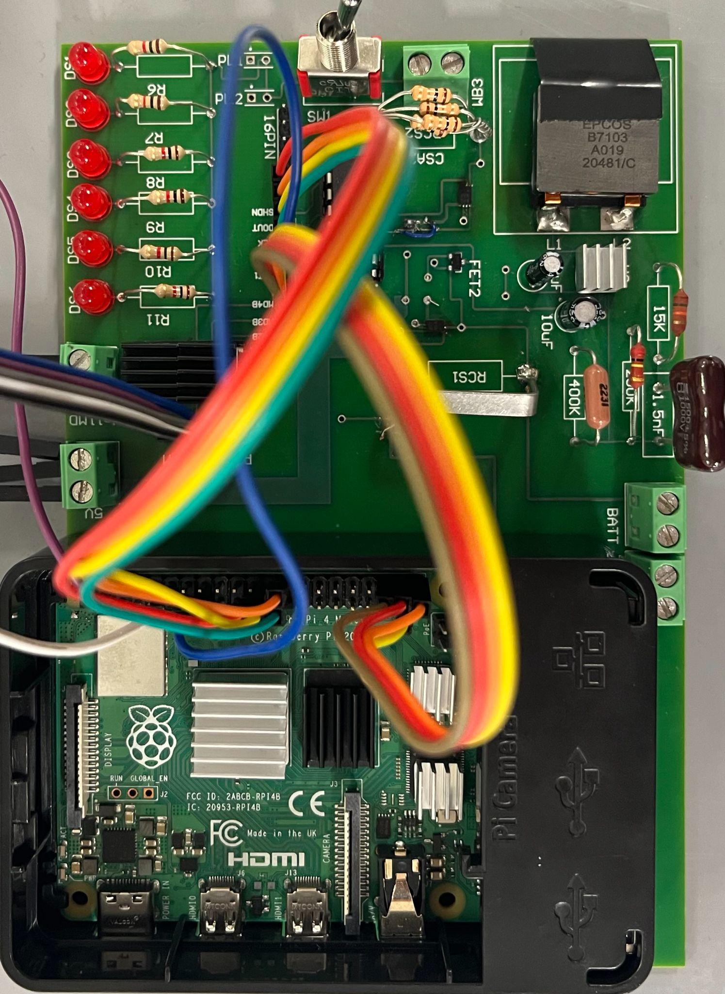
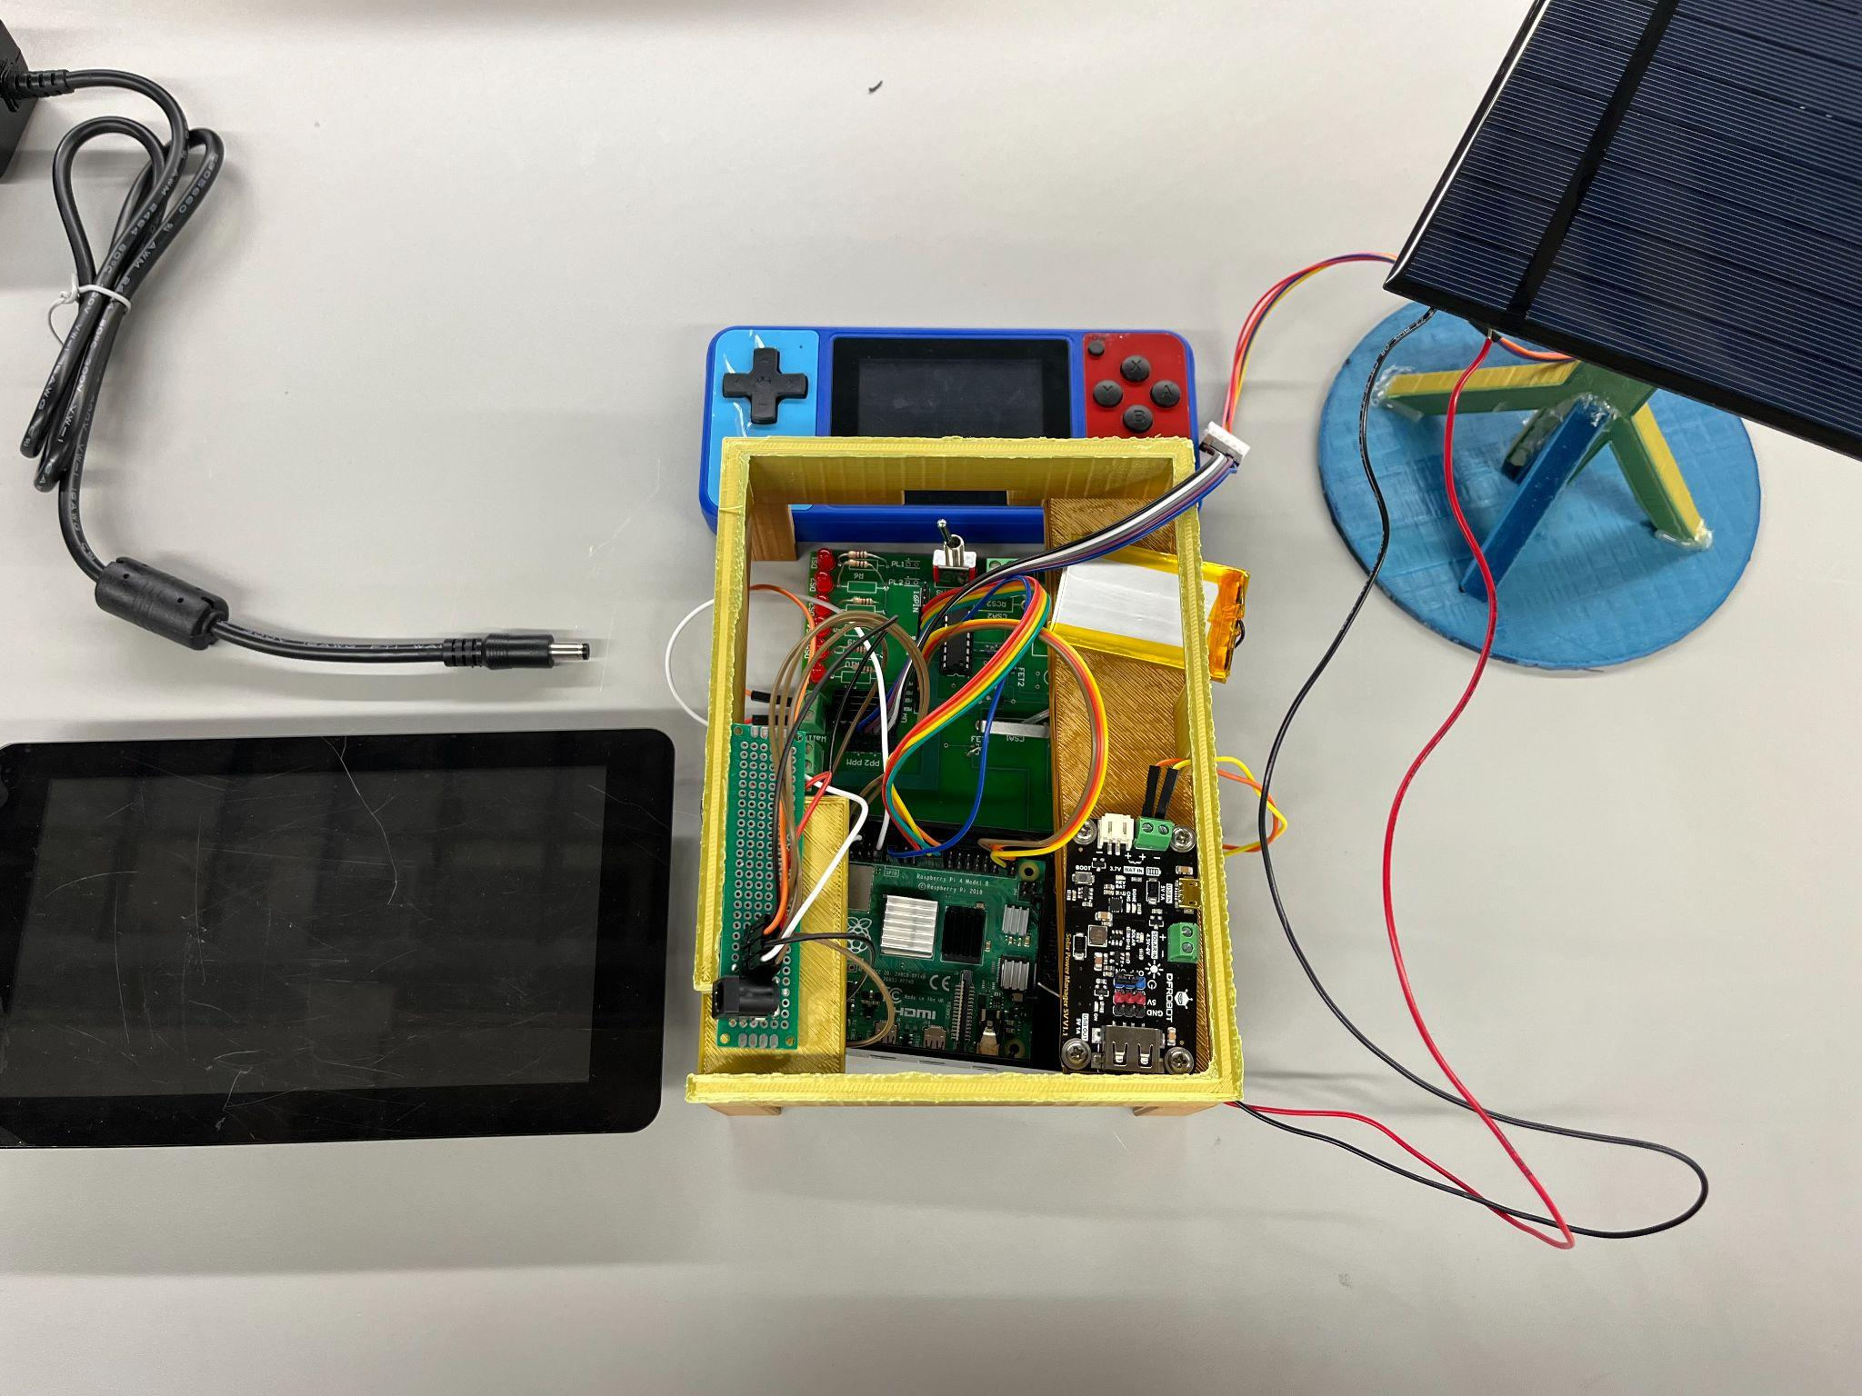
Final System
Loads
ADC
Solar Panel and Motor
Gameboy
Buck-Boost
Converter
CSAs &
FETs
Battery &
Charge Controller Ports
Motor Driver
Battery & Charge Controller
Touch Screen
Raspberry Pi

Slide 5
Solar Power Generation George Thuita
Overview: Convert solar radiation into power by charging a battery. Feed battery power to a regulator to power various loads.
Issues:
Solar panel didn’t function properly in integrated system
Buck-boost converter oscillated during high current draw
PCB nets flipped between VDD and GND on CSAs
Solutions:
Use higher power panel to pump more current into charge controller
Use higher current output converter and optimize PCB layout to avoid current peak and voltage droops
Use blue wire to resolder correct nets from cut traces

Slide 6
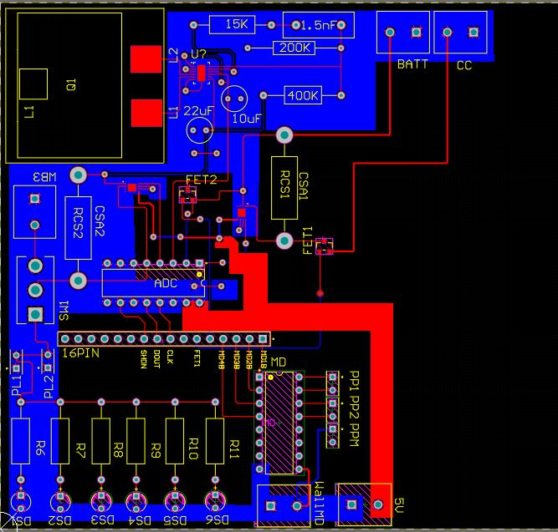
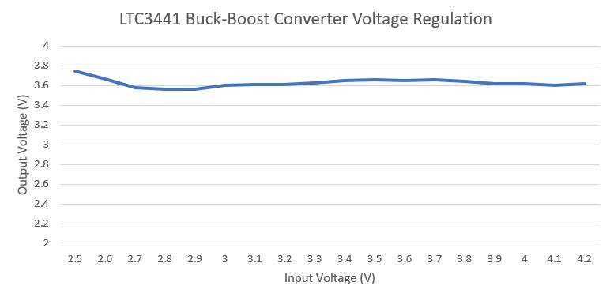
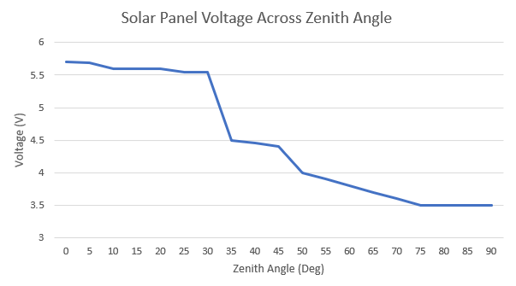
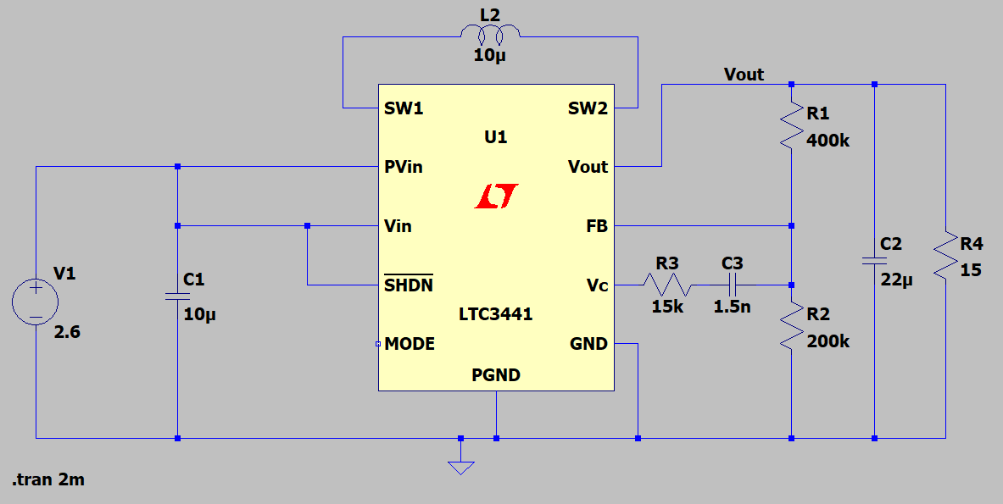
Solar Power Generation (2) George Thuita
PCB Layout
Improved Buck-Boost Converter Schematic

Slide 7
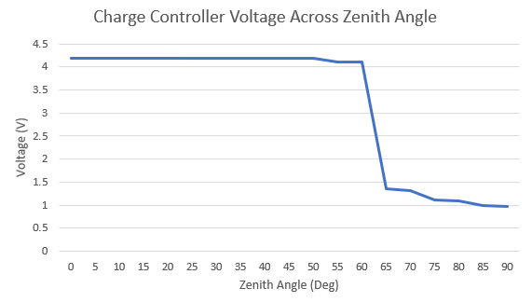
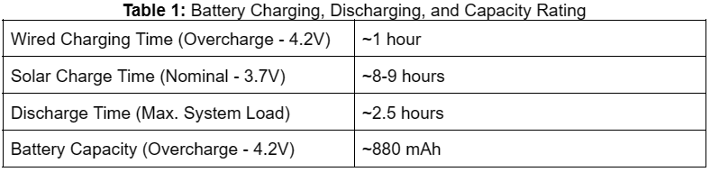
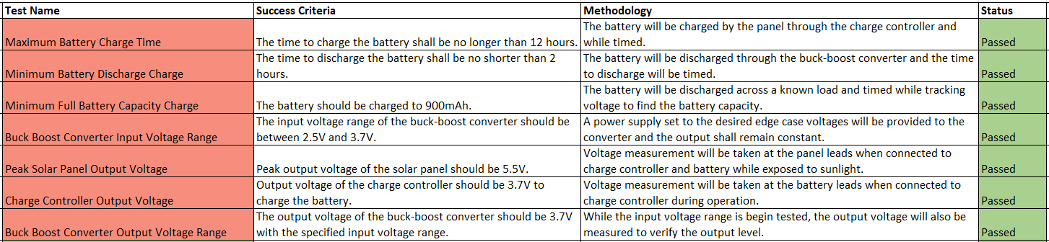
Solar Power Generation (3) George Thuita
Validation

Slide 8
Electrical I/O Leo Predanic
Overview: Use an ADC to measure both voltage and current to various system points. Compile data for processing. Implement system switching functionality and motor control.
Issues:
Charge side FET was not operating properly due to floating VGS
ADC samples were inaccurate with initial design
Panel rotation algorithm had too much delay when integrated
Solutions:
Remove FET due to reverse current protection at charge controller
Optimize sense resistor sizing for optimal voltage drop based on current flow and gain
Reduce step count and integrate algorithm with ADC sensing to reduce overall delay

Slide 9
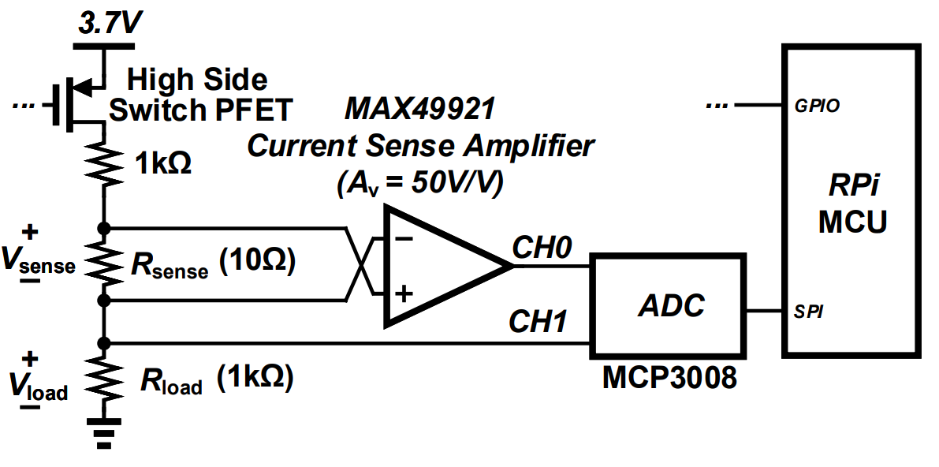
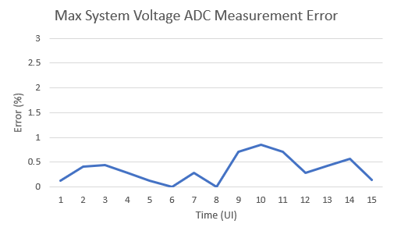
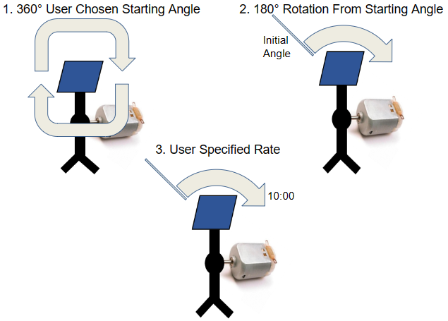
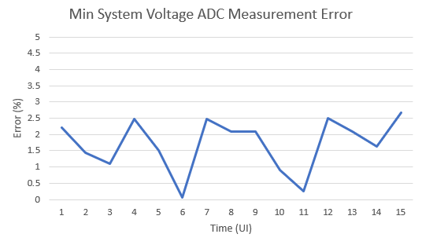
Electrical I/O (2) Leo Predanic
ADC Sensing Schematic
Solar Panel Rotation Algorithm Flow

Slide 10
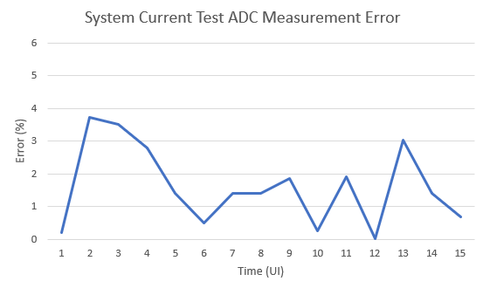
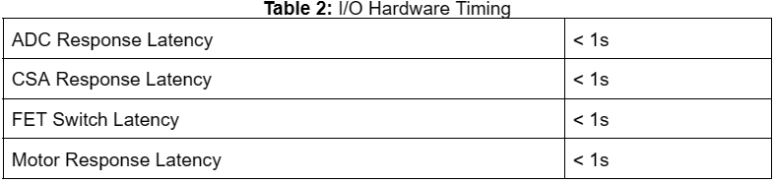
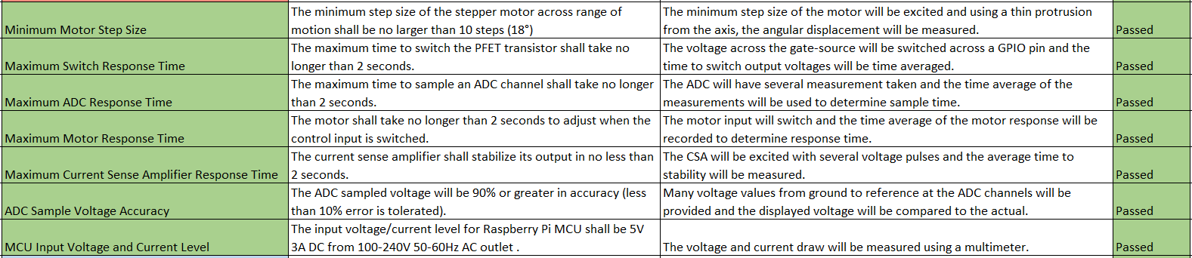
Electrical I/O (3) Leo Predanic
Validation

Slide 11
GUI, Database, & Animations Brandon Cenci
Overview: Read/write data from ADC to displays in real time and store in database. Provide user interaction features to control system and observe performance. Create animations which act as a teaching tool to articulate system operation at a novice level for easy understanding.
Issues:
Delay propagation occurring during data collection
Issue updating graphs while maintaining system operation
Ensuring motor control without interfering with other functionality
Solutions:
Altered algorithm to control pacing of data collection, animation, and motor control
Minimized sample duration as well as period while still ensuring proper data analysis
Incorporating motor control functionality into same main function as all other system operations

Slide 12
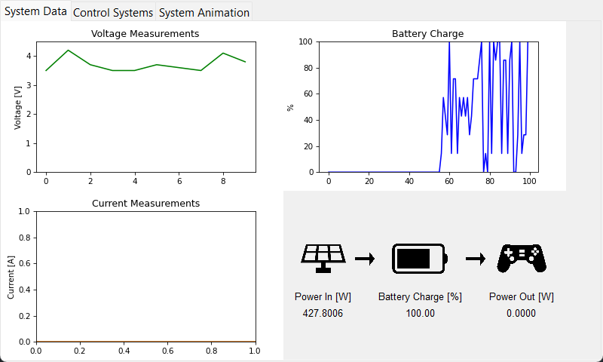
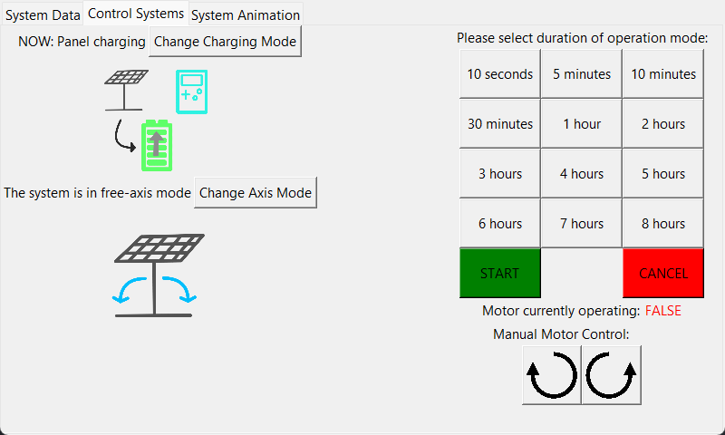
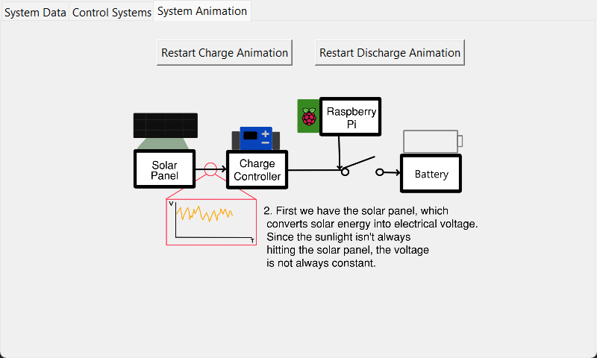
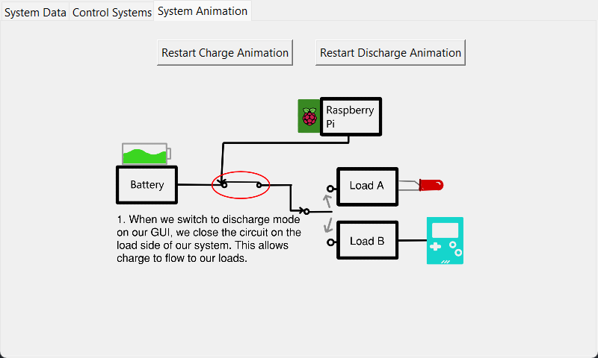
GUI, Database, & Animations (2) Brandon Cenci
Data Collection Tab
Motor Control Tab
System Animation Tab (Charge Animation)
System Animation Tab (Discharge Animation)

Slide 13
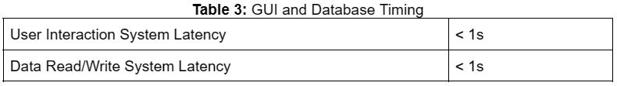
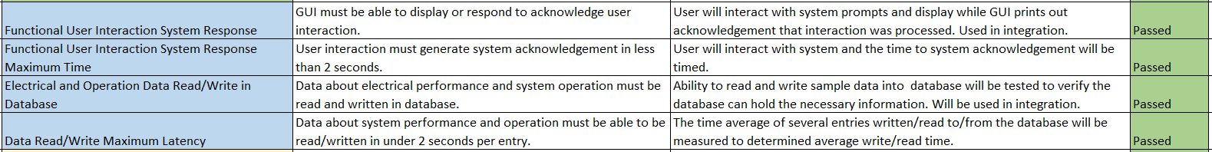
GUI, Database, & Animations (3) Brandon Cenci
Validation

Slide 14
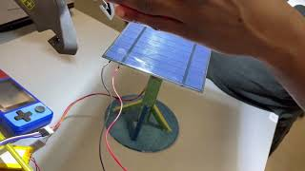
Integrated System Results George Thuita/Leo Predanic/Brandon Cenci
GUI Voltage and Current Measurement (Solar Charging)

Slide 15
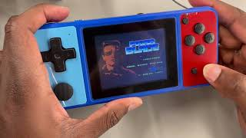
Integrated System Results (2) George Thuita/Leo Predanic/Brandon Cenci
GUI Voltage and Current Measurement (Load)

Slide 16
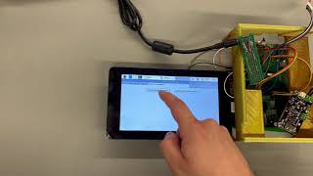
Integrated System Results (3) George Thuita/Leo Predanic/Brandon Cenci
Charge/Discharge Side Animations

Slide 17
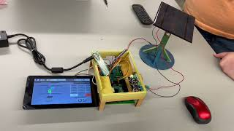
Integrated System Results (4) George Thuita/Leo Predanic/Brandon Cenci
GUI Motor Control

Slide 18
Conclusion
Overall system completed and validated
Changes in solar panel, buck-boost converter, rotation algorithm, and GUI overhaul to improve system performance and accuracy
Budget constraint was met
Project specifications were met with minimal error:
ADC sensing error is low
Latency is low
Wide angle of rotation for charging
Ease-of-use GUI design and implementation
Functional charging and discharging capabilities
Future improvements:
Easy battery and load replacement (tunable output voltage)
Higher power converter for more intensive loads
Dual-axis solar panel rotation

Slide 19
Thank You!
Questions?

